Slide 1


Transportation Systems (CV705T)
UNIT I
Prof. Yogesh S. Lanjewar
Assistant Professor
DEPARTMENT OF CIVIL ENGINEERING
St. VINCENT PALLOTTI COLLEGE OF ENGINEERING & TECHNOLOGY,NAGPUR

Slide 2
Contents
Highway Geometric Design:
Cross Section elements
Carriageways
Camber
stopping & overtaking sight distances.

Slide 3
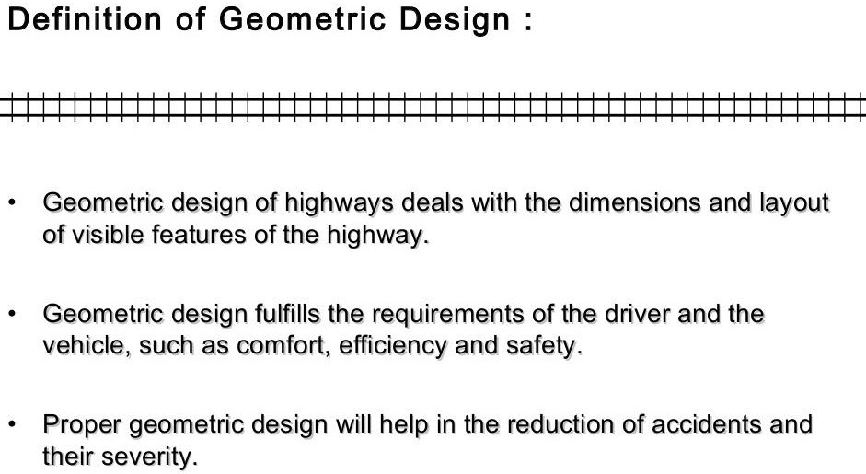
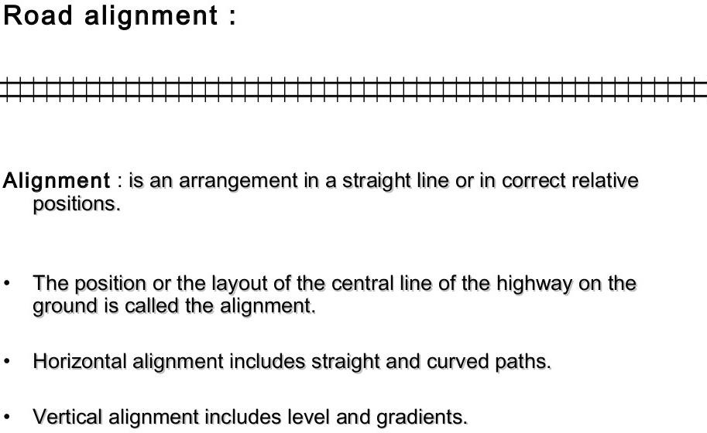

Slide 4
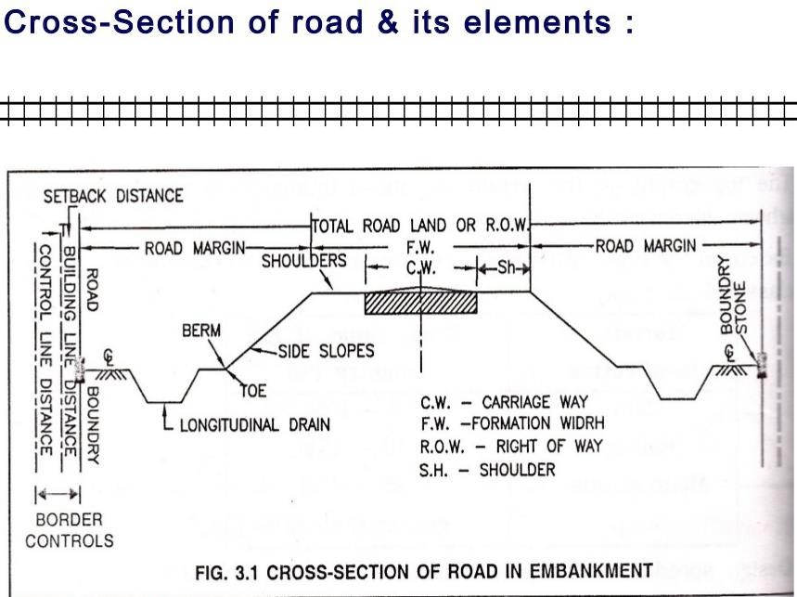

Slide 5
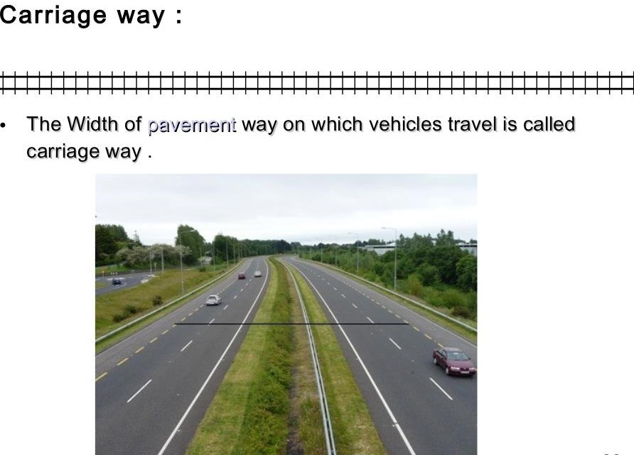
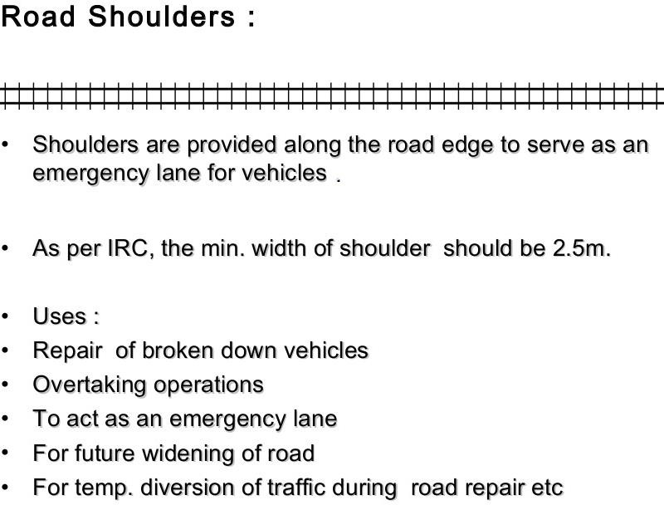

Slide 6
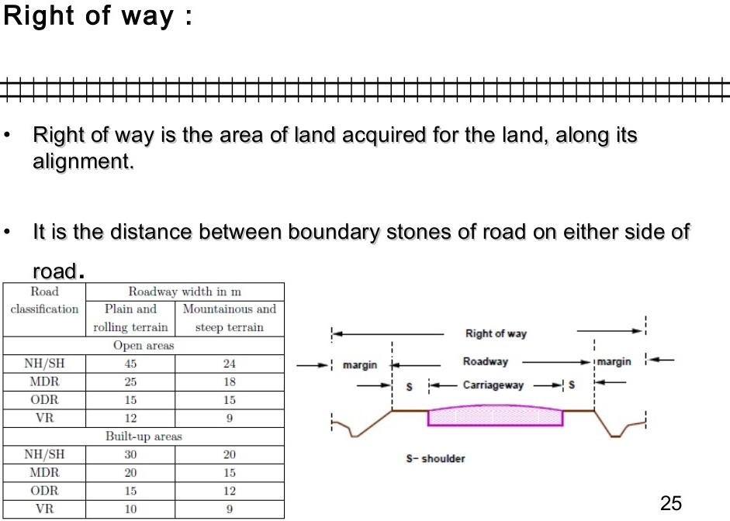

Slide 7
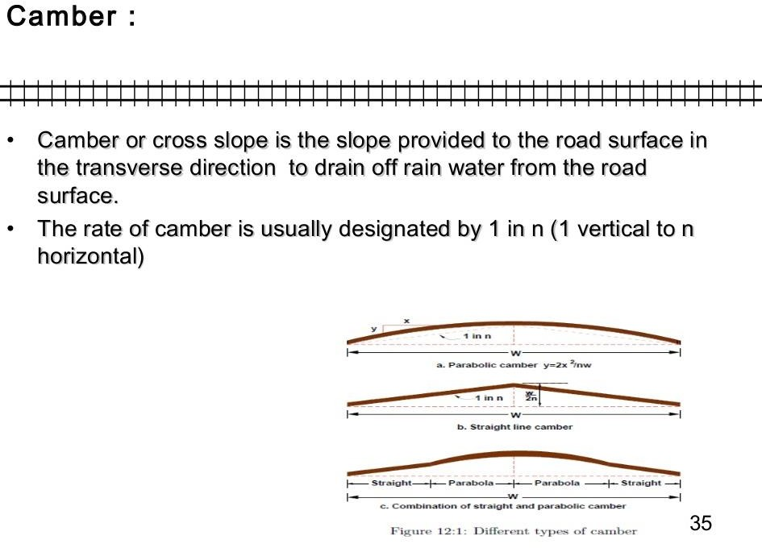

Slide 8
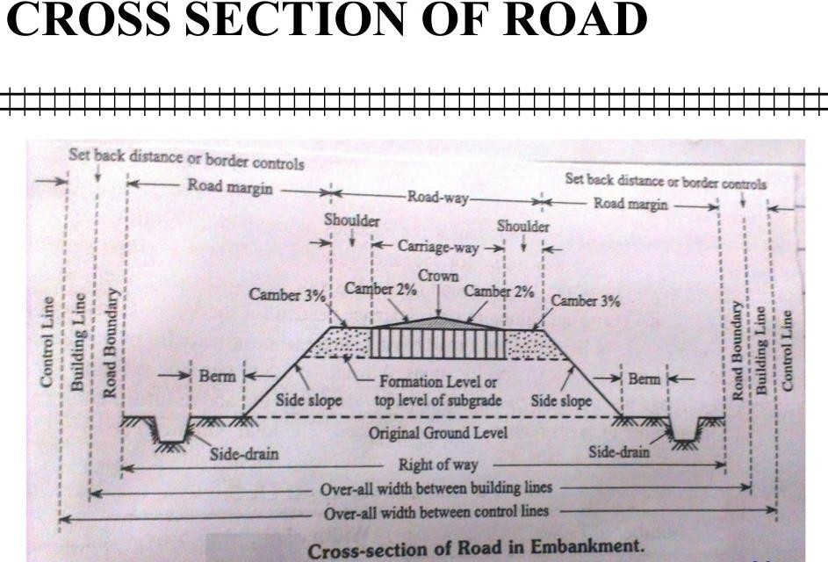

Slide 9
Importance of geometricdesign
The geometric design of a highway deals with the dimensions and layout of visible features of the highway such as alignment, sight distance and intersection.
The main objective of highway design is to provide optimum efficiency in traffic operation with maximum safety at reasonable cost.
Geometric design of highways deals with following elements :
Cross section elements
Sight distance considerations
Horizontal alignment details
Vertical alignment details
Intersection elements

Slide 10
Design Controls and criteria
Design speed
Topography
Traffic factors
Design hourly volume and capacity
Environmental and other factors Design speed
In India different speed standards have been assigned for different class of road
Design speed may be modified depending upon the terrain conditions.

Slide 11
Highway cross section elements
Carriageway
Shoulder
Roadway width
Right of way
Building line
Control line
Median
Camber/ cross slope
Crown
Side slope
Kerb
Guard rail
Side drain
Other facilities

Slide 12
Carriageway
It is the travel way which is used for movement of vehicle, it takes the vehicular loading .
It may be cement concrete road or bituminous pavement.
Width of carriageway is determined on the basis of the width of the
vehicle and the minimum side clearance for safety.
As per IRC specification, the maximum width of vehicle is 2.44m,minimum clearance of 0.68 in case of single lane and 1.02m in case of double lane.

Slide 13
 |  | WIDTH OF CARRIAGEWAY
SL.NO. | Class ofroad |  | Width of carriageway in ‘m’
1 | Single lane |  | 3.75
2 | Two lane without raised kerbs |  | 7.0
3 | Two lane with raised kerbs |  | 7.5
4 | Intermediate lane |  | 5.5
5 | Multilane pavement |  | 3.5/lane
 |  | WIDTH OFROADWAYOFVARIOUS CLASSESOFROADS
SL. No. | Roadclassification |  | Roadwaywisth
 |  |  | Plane and rol ing terrain | Mountainous and steep terrain
1 | NH & SH Single lane two lane |  | 12 12 | 6.25 6.25
2 | MDR Single lane two lane |  | 9 9 | 4.75 4.75
3 | ODR Single lane two lane |  | 7.5 9 | 4.75 4.75
4 | Vilage roads-single lane |  | 7.5 | 4

Slide 14
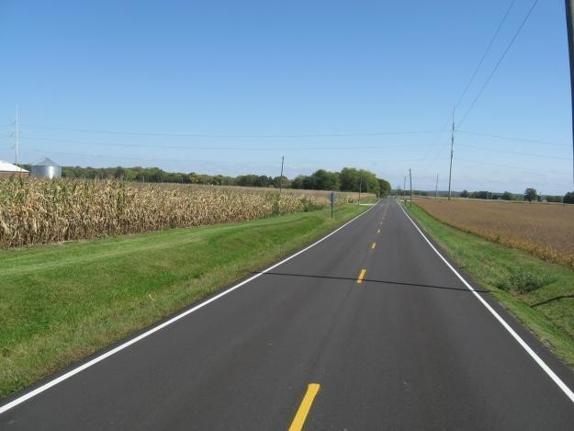
Two lane two-way road
carriageway

Slide 15
Shoulder
It is provided along the road edge to serve as an emergency lane for vehicle.
It act as a service lane for vehicles that have broken down.
The minimum shoulder width of 4.6 m so that a truck stationed at the side of the shoulder would have a clearance of 1.85m from the pavement edge.
IRC recommended the minimum shoulder width is 2.5 m
It should have sufficient load bearing capacity even in wet weather.
The surface of the should be rougher than the traffic lanes so that vehicles are discouraged to use the shoulder as a regular traffic.
The colour should be different from that of the pavement so as to be distinct.

Slide 16
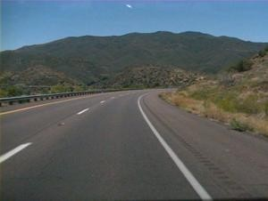
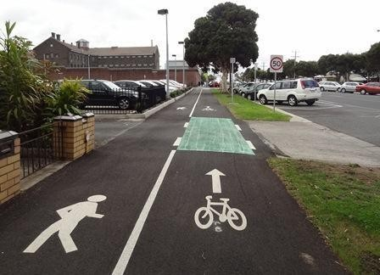
shoulder
Cycle track
Footpath

Slide 17
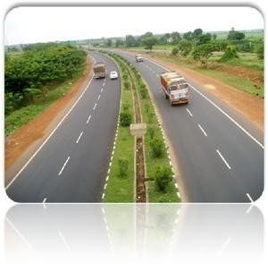
Treated
shoulder
unTreated
shoulder

Slide 18
Width of the roadway or formation width:
It is the sum of the width of the carriageway or pavement including separators if any and the shoulders.
Right of way:
It is the total area of land acquired for the road along its alignment.
It depends on the importance of the road and possible future development.
It is desirable to acquire more width of land as the cost of adjoining land invariably increases very much , soon after the new highway is constructed.

Slide 19
Building lane:
In order to reserve sufficient space for future development of roads, It is desirable to control the building activities on either side of the road boundary, beyond the land width acquired for the land.
Control lines:
In addition to “building line”, it is desirable to control the nature of building upto further “set back distance” .

Slide 20
Traffic separators or median:
The main function is to prevent head on collision between the vehicle moving in opposite direction.
Channelize traffic into streams at intersection.
Segregate slow traffic and to protect pedestrians.
IRC recommends a minimum desirable width of 5 m and may be reduce to 3 m where land is restricted.
The minimum width of median in urban area is 1.2m.

Slide 21
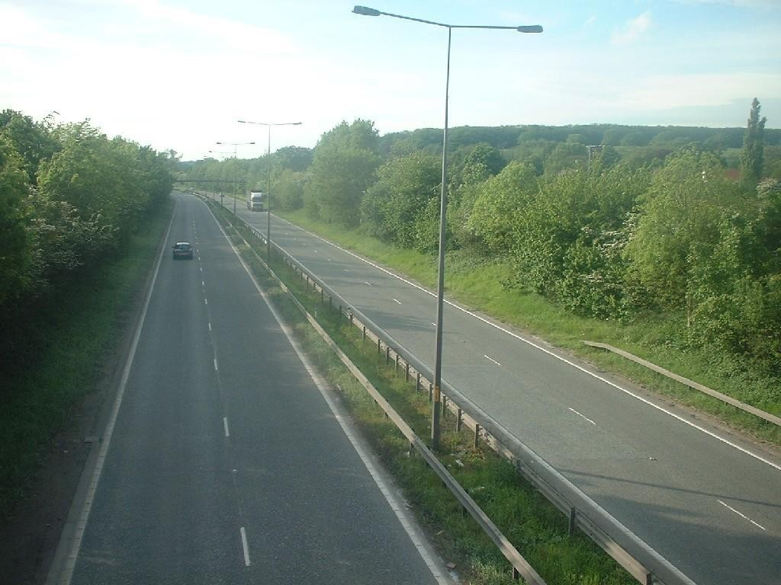
4-lane divided carriage way or dual carriage way
Median/
separator

Slide 22
Cross slope or camber:
It is the slope provided to the road surface in the transverse direction to drain off the rain water from the road surface.
To prevent the entry of surface water into the subgrade soil through pavement.
To prevent the entry of water into the bituminous pavement layer.
To remove the rain water from the pavement surface as quick as possible and to allow the pavement to get dry soon after the rain.
It is expressed as a percentage or 1V:Nh.
It depends on the pavement surface and amount of rainfall.

Slide 23
Shape of the cross slope:
Parabolic shape(fast moving vehicle)
Straight line
Combination of parabolic and straight line
 | Recommended values of camber for different types of road surface
Sl no. |  | Type of road surface | Range of camber in areas of rain fall range
 |  |  | heavy | light
1 |  | Cement concrete and high type bituminous pavement | 1 in 50(2%) | 1 in 60(1.7%)
2 |  | Thin bituminous surface | 1 in 40(2.5%) | 1 in 50(2%)
3 |  | Water bound macadam(WBM) and gravel pavement | I in 33(3%) | 1 in 40(2.5%)
4 |  | Earth | 1 in 25(4%) | 1 in 33(3%)

Slide 24
Kerb:
It indicates the boundary between the pavement and shoulder.
It is desirable to provide kerbs in urban areas.

Slide 25
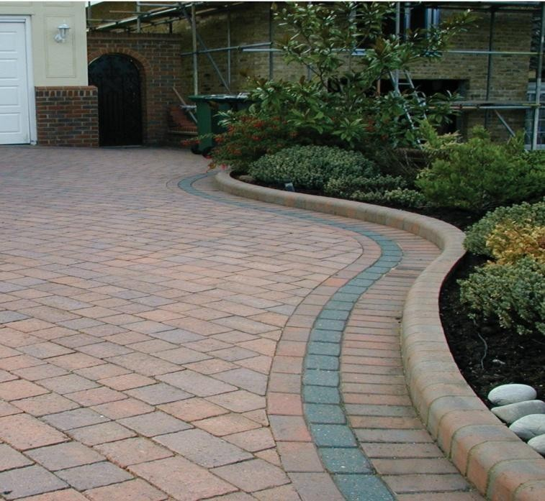
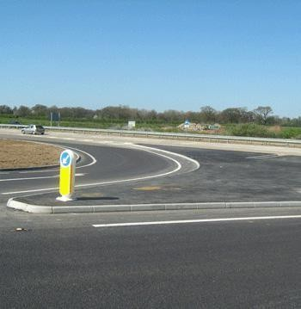
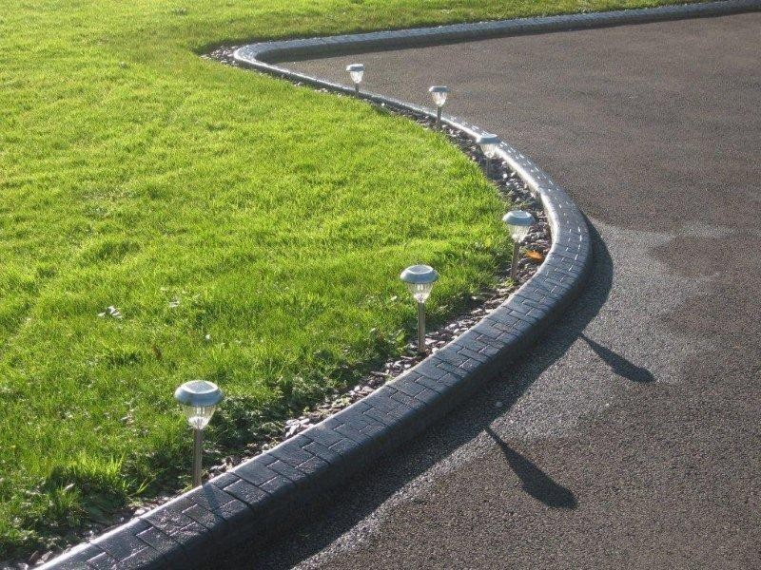
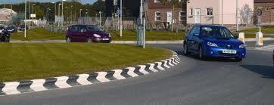
kerb

Slide 26
Guard rail
It is provided at the edge of the shoulder when the road is constructed on
a fill exceeds 3 m.
It is also provided on horizontal curve so as to provide a better night visibility of the curves under the head light of the vehicle.

Slide 27
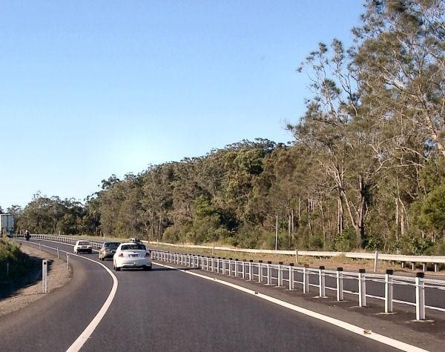
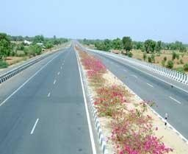
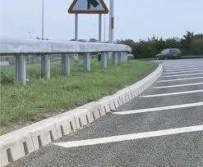
Guard rail

Slide 28
Roadmargins
Parking lane:
These are provided on urban roads to allow kerb parking
As far as possible only parallel parking should be allowed as it is safer for moving vehicle.
It should have sufficient width say 3m
Lay bay:
These are provided near the public conveniences with guide map to enable driver to stop clear off the carriageway.
It has 3m width,30m length with 15m end tapers on both sides.
Bus bays:
These may be provided by recessing the kerb to avoid conflict with moving traffic.
It is located atleast 75m away from the intersection.

Slide 29
Frontage road:
These are provided to give access to properties along an important highway with
control access to express way or free way
It may run parallel to the highway and are isolated by separator.
Driveway:
It connect the highway with commercial establishment like fuel stations, service stations
etc…
It should be located away from the intersection.
Cycle track:
It provided in urban areas when the volume of cycle traffic on the road
is very high.
A minimum width of 2m is provided for cycle track.
Footpath:
These are provided in urban areas when the vehicular as well as pedestrian traffic are heavy.
To protect the pedestrian and decrease accident.
Minimum width of 1.5m is provided.

Slide 30
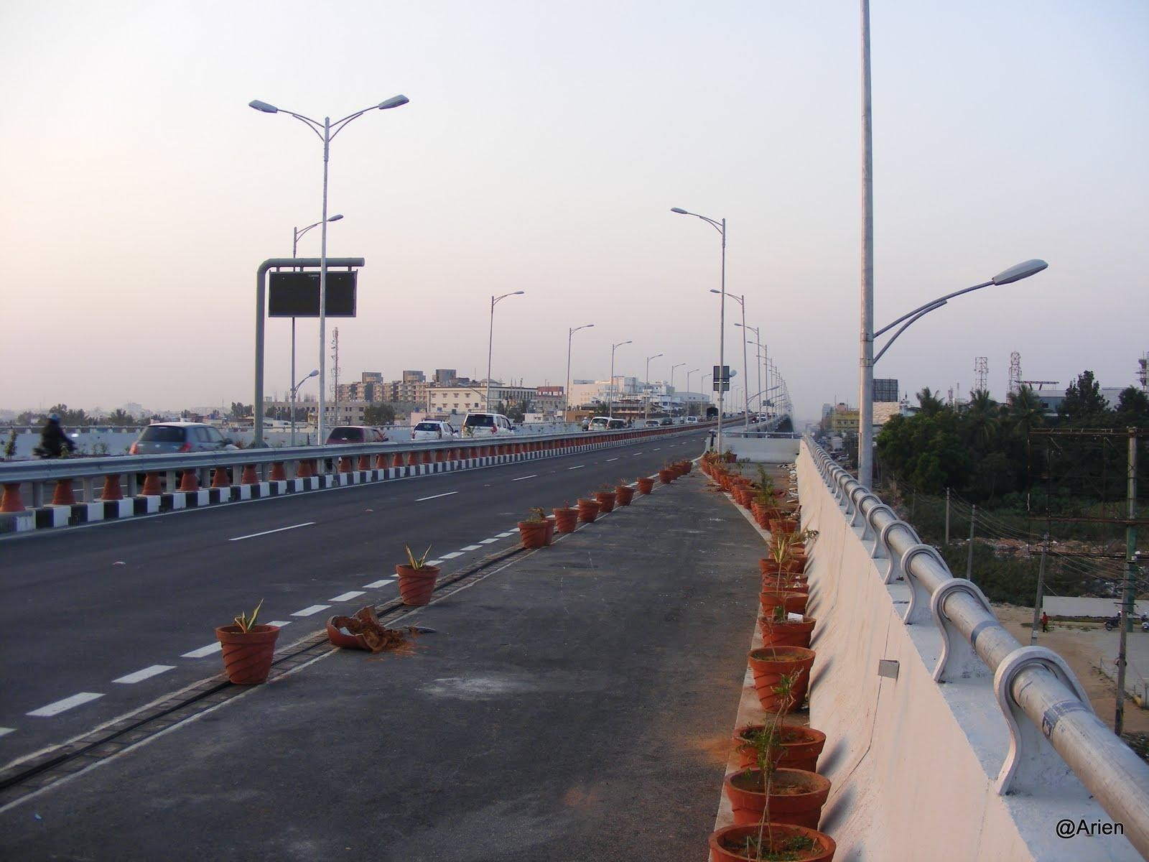

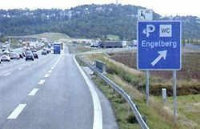
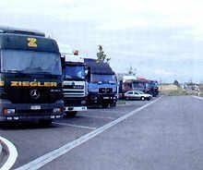

Slide 31
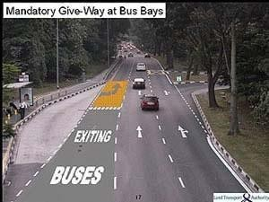
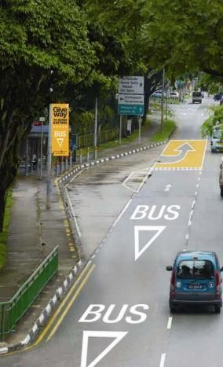
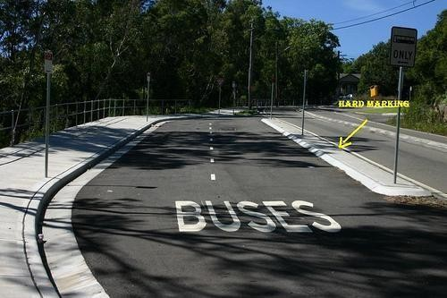
Bus bays

Slide 32
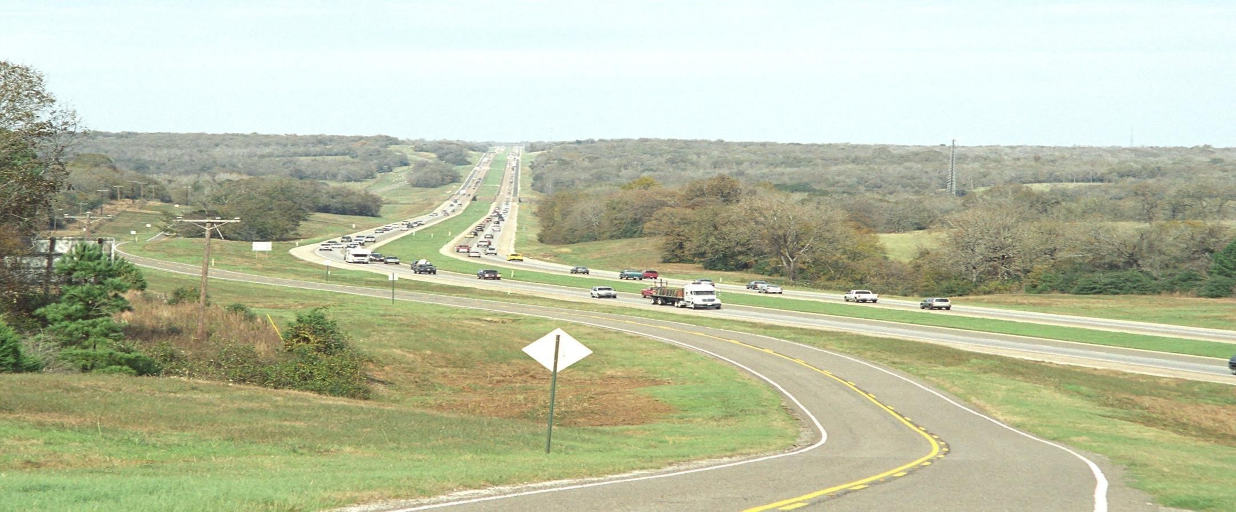
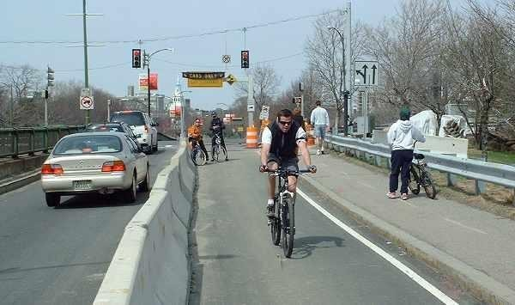
Frontage road

Slide 33
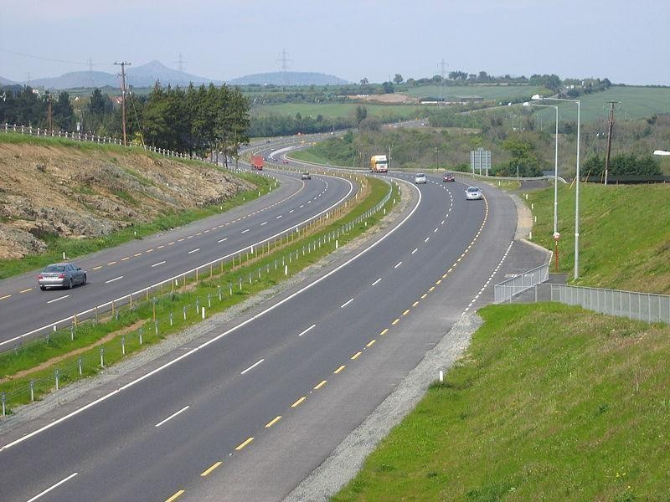

Slide 34
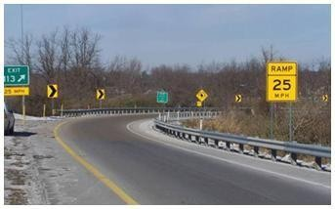
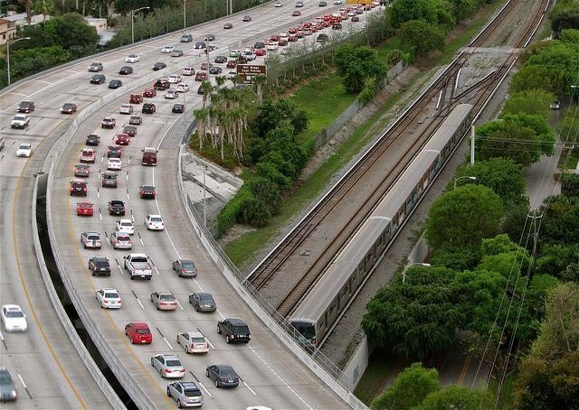
Guard rails

Slide 35


